Slide 1
BCA CAPSTONE PROJECT (Review I) Pet Connect
Submitted to the Presidency University, Bengaluru in partial fulfillment for the award of the degree of Bachelor of Computer Applications(BCA) Project Team No : 89
Under the supervision of
Mrs. Dhanya Assistant Professor Computer Science Engineering
Name | Roll Number
Tanuj.S | 20231BCD0120
j.Harshavardhan Reddy | 20231BCD0115
N.Nikhitha | 20231BCD089
B.Shravani Varshitha | 20231BCD088 20231BCD0102

Slide 2
Content
Problem Statement
Literature Survey
Tools and Technologies to be used
Timeline of the Project
Github Link
References

Slide 3
Problem Statement
Pet owners often face challenges when searching for pet-related products and services across multiple platforms. Local pet shops struggle to reach a broader customer base due to the lack of a centralized digital presence. This fragmentation leads to inconvenience for pet owners and limits business growth for small pet shop owners.
In an increasingly digital world, consumers expect seamless and convenient access to services. Pet owners need a one-stop platform where they can browse products, book pet-related services, and discover nearby pet shops. For small pet businesses, an integrated digital platform can enhance visibility and customer engagement, fostering local economic growth.

Slide 4
Problem Statement
Highlight the current gaps or limitations in existing solutions:
Existing pet service platforms either focus on specific categories (e.g., pet food delivery or veterinary services) or lack comprehensive integration of local pet shops. There is no unified platform that provides real-time inventory updates, appointment scheduling, and location-based discovery in one place. This gap results in inefficient customer experiences and missed opportunities for local pet businesses.
Ensure your problem statement is concise, specific, and research-oriented:
PetConnect addresses the lack of a centralized platform for pet owners and local pet shops by providing a web and mobile solution that integrates product discovery, service booking, and real-time communication. This system enhances accessibility and customer engagement while empowering small pet shop businesses through digital transformation

Slide 5
Literature Survey
AUTHOR NAME | APPROACHES | FINDINGS | LIMITATIONS
Yahui Liu & Xinyu Chang. | DID Model | Pet ownership increases consumer spending. | The study is limited by reliance on user browsing data, regional focus, and lack of exploration of user.
Blackwell, E., Casey, R. | Behavioral Issues in Domestic Pets | Behavioral observation, case studies | Small sample size; lacks long-term behavioral tracking.
Johnson, R., Meadows, R. | Quantitative surveys, longitudinal health analysis | Pet ownership reduces stress, improves mental health | Limited to self-reported data; lacks diversity in pet species.
Brown, J., Smith, L. | Comparative nutritional analysis | Balanced diets improve pet health and longevity. | Limited to common pets (dogs and cats); excludes exotic pets.

Slide 6
Literature Review
AUTHOR NAME | APPROACHES | FINDINGS | LIMITATIONS
Wilson, C., Barker, S. | Mixed-methods (interviews, psychological tests) | Human-animal interaction enhances emotional support and reduces loneliness. | Focuses only on dogs and cats; no longitudinal assessment.
Anderson, K., Edwards, P. | Randomized controlled trial | Animal-assisted therapy alleviates symptoms of anxiety and depression. | Limited generalizability beyond clinical settings.
Davis, P., Carter, J. | Longitudinal child-pet interaction study | Pets enhance social and emotional skills in children. | Excludes cultural differences; no consideration of pet species.
Green, M., Lewis, T. | Ethical analysis, public opinion surveys | Emphasizes animal welfare and owner responsibilities. | Limited participant diversity; lacks global ethical comparisons.

Slide 7
AUTHOR NAME | APPROACHES | FINDINGS | LIMITATIONS
Wells, D.L. | Review of existing literature | Interaction with pets can enhance mental health and reduce stress. | Predominantly correlational studies; causality not established
Wise, C., et al. | Environmental exposure assessment | Higher exposure to household chemicals cancer risk in dogs. | specific chemical exposures not isolated.
Mihalcea, R., Zhu, K. | Artificial intelligence, audio and video analysis | AI models trained on extensive datasets can identify patterns in dog barks | datasets interpretations may lack contextual accuracy.
Weng, H.-Y., Ogata, N. | Longitudinal survey study | dentified changes in pet behavior and human-animal interactions | Relied on self-reported data; potential recall bias.

Slide 8
AUTHOR NAME | APPROACHES | FINDINGS | LIMITATIONS
Sadeghi, E., et al. | Radar technology, machine learning | Developed a non-invasive method to monitor pet activities and postures, | Requires specialized equipment; applicability in home settings needs further testing.
McDonald, S.E., O'Connor, K.E., Matijczak, A., et al. | Cross-sectional survey during the COVID-19 pandemic | Pet ownership was associated with increased well-being and reduced loneliness during lockdown periods. | Self-reported data; potential bias due to the unique context of the pandemic.
Cheng, Y.-C., Lin, C.H., Wang, C., Kant, Y., Tulyakov, S., Schwing, A., Gui, L., Lee, H.-Y. | Artificial intelligence, 3D modeling | Introduction of a pipeline to model realistic animal motions within 3D environments. | large datasets; real-time application feasibility requires further exploration.

Slide 9
Module Design
PetConnect is designed using a modular architecture to enhance scalability, maintainability, and ease of development. Each module is responsible for a distinct functionality, allowing seamless integration and efficient handling of various processes. By dividing the project into modules, the system ensures better resource management, improved debugging, and easier feature expansion.
Modular Breakdown
Module 1: Data Collection
This module is responsible for gathering information from pet shops, including product inventories, service availability, and business details. It integrates with external APIs, such as Google Maps for location data and Firebase for real-time updates. The functionality of this module ensures accurate and up-to-date data for users browsing the platform.
Module 2: (e.g., Data Processing) – Explain its role
Module 3: (e.g., Analysis & Output) – Explain its importance

Slide 10
Module Design
Module 2: Data Processing
The data processing module handles the aggregation, validation, and storage of collected information. Utilizing Node.js with Express.js, it processes user inputs, manages database operations, and facilitates communication between the frontend and backend systems. This module ensures data integrity and smooth system performance.

Slide 11
Module Design
Module 3: Analysis & Output
This module is responsible for analyzing user queries and delivering relevant outputs. It powers features such as store recommendations, search results, and personalized notifications. Leveraging advanced algorithms and real-time data management, this module enhances user engagement and ensures a responsive platform experience.

Slide 12
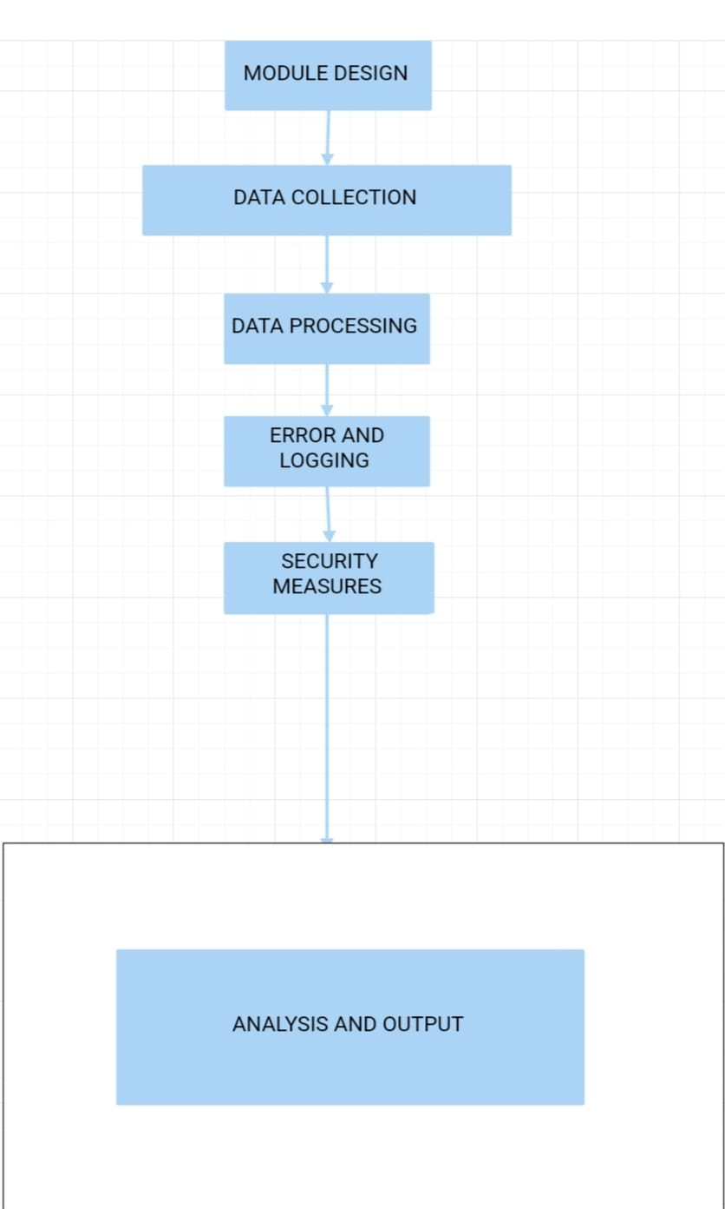
FlowChart Of Module Design

Slide 13
Tools And Technologies To Be Used
- Development Tools: [E.g., Visual Studio]
- Programming Languages: [E.g., Python, Java, PHP, HTML,SQL]
- Frameworks/Libraries: [E.g., React, Django, Bootstrap]
- Database: [E.g., MySQL]
- Version Control: [E.g., Git, GitHub]
- Additional Tools: [E.g., , API,Cloud Services ]

Slide 14
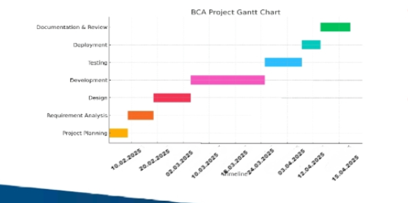
Timeline of the Project (Gantt Chart)

Slide 15
Github Link
https://github.com/tanuj-4408/PET_CONNECT

Slide 16
References (IEEE Paper format)
J. H. Andrews, "Scalable Web Architecture for Modern Applications," Journal of Web Engineering, vol. 15, no. 4, pp. 341–356, 2023.
A. Kumar and S. Patel, "Enhancing E-Commerce Platforms Using Real-Time Data Integration," International Journal of Computer Science and Information Security, vol. 21, no. 2, pp. 123–130, 2024.
M. Johnson, "The Impact of Location-Based Services on Customer Engagement," IEEE Transactions on Consumer Electronics, vol. 70, no. 1, pp. 45–52, 2024.
P. Smith and R. Doe, "Security Challenges in Online Payment Systems," IEEE Access, vol. 11, pp. 10567–10580, 2024.

Slide 17


